Slide 1
Law Faculty of National Aviation University, Ukraine

Slide 2
National Aviation University (NAU), Law Faculty
General information:
Number of students: 562
Number of teaching staff: 102
48 – teaching staff,
54 scientific and pedagogical staff
Number of chairs: 6
Founting date:
of the University: 1905
of Law Faculty: 2000
Law Faculty of NAU carries out trainig of legal experts for programs of educational degrees "Bachelor", "Master". The special feature of the faculty is additional profiling in air and space law, internships in the legal departments of airlines, air enterprises and in relevant international organizations

Slide 3
STRUCTURE OF STUDIES SPECIALIZATION
Discipline | Specialty Educational and professional programs | SPECIALIZATION
Law | Legal support of customs activity | Transport law; Civil and labor law; Business law; Public service; Court. Advocacy. The Public Prosecutor's Office. Notary
Civil Security | Law enforcement activities | Criminal procedural activity of law enforcement agencies; Administrative and procedural activities of law enforcement agencies

Slide 4
PREVIOUS EXPERIENCES WITH REGIONAL OR INTERNATIONAL COOPERATIONS

Slide 5
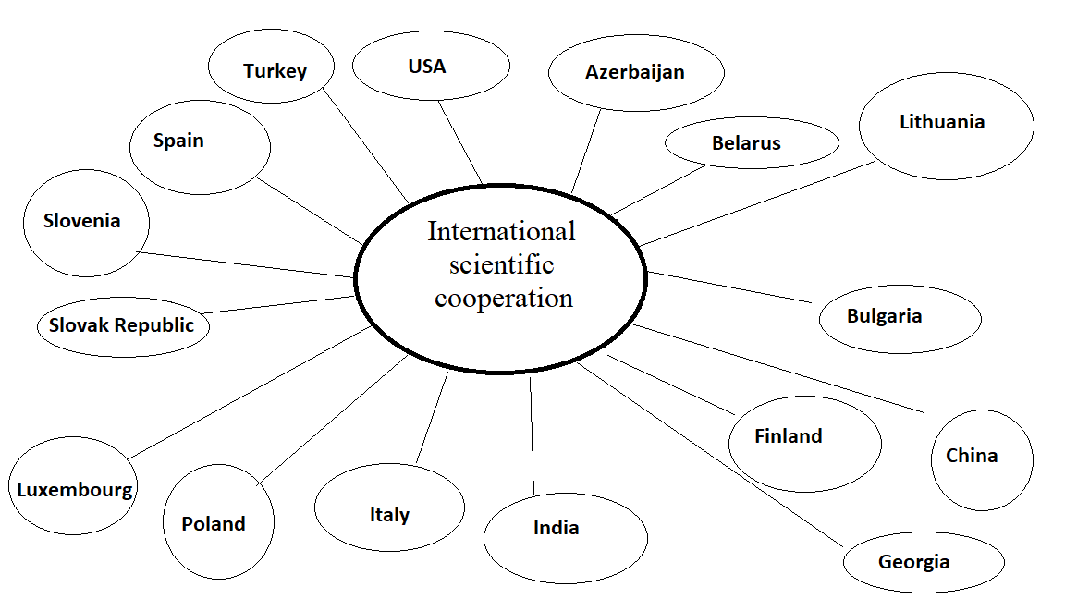
The Leavitt Institute for International Development
Medianet Istanbul University
Aviation Academy, Baku State University
Branch of the Russian State Social University in Minsk
Vilnius University
Academy of Melitense
University of Ljubljana
Chornoryztsya Khrabra Varna Free University
Scientific Consulting Community s.r.o. ”Open Europe”, Eastern European Development Agency, European Institute for Continuing Education, Dubnicky Technology Institut
Ningbo University of Technology
Turku University, Faculty of Law
Center for the Study of European Reforms
University of Turin
High School of Trade in Radom, Maria Curie-Skłodowska University, Naval Academy in Slupsk
Himachal Pradesh National Law University (Gurwinder Singh, PhD in International law)
Caucasian International University, Guram Tavartkiladze Teaching University

Slide 6
International projects
Joint organization and participation in conferences, in the editorial journal “Legal Bulletin. Air and Space Law” and “Vedetsky Journal”
Joint scientific research
Organization of summer school work
Research and publishing cooperation in scientific rights
Joint organization and participation in the conference
Research and editorial cooperation in international law
Organization of internships
Joint scientific research
Academic mobility of business and academic staff
Collaborative Science and Research Software, Exchange of Academic Materials, Publications, Collaborative Study of Symposia, Conferences and Seminars
Research and publishing cooperation in scientific rights

Slide 7
Regional coorperations with national faculties/universities
NAU has close cooperation with all national faculties/universities. Main partners on a national level are:
The Institute of Legislation of the Verkhovna Rada (Supreme Council) of Ukraine,
Koretsky Institute of State and Law of the National Academy of Sciences
Zaporizhzhya National University
National Academy of Internal Affairs,
Vadym Hetman National University of Economics (KNEU)
and others

Slide 8
Regional projects
Organization of inter-universities scientific-methodological and scientific-practical seminars, workshops
Editorial work on a journal “Legal Bulletin. Air and Space Law”
Scientific research cooperation
Educational - methodical cooperation
Educational cooperation
Joint organization and participation in conferences
Research and publishing cooperation in scientific rights
Organization and participation in the AVIA International Scientific and Technical Conference
Research and editorial cooperation in legal scince
Organization of International Scientific and Practical Conference for the Day of Science “Youth Scientific Legal Forum Joint scientific research

Slide 9
CHALLENGES & OPPORTUNITIES
1) Which challenges do you see in the development of your society in the region?
social problems, emerged after the Russian military intervention in Ukraine;
obstacles on the way of Ukrainian people´s unity in choosing the only one vector of social development;
inability to self-organize and unite for common action, marginalization of public life,
inability of CSOs to inform the population about their role and to involve citizens in their activities…
2) Where do you see the responsibility of the higher education institutions?
raising of a level of civic education of youth;
improvement of the legal framework regulating the activity of civil society organizations;
implementation of training courses on civil society development and CSO with mandatory practice in CSO;
higher education institutions are the places, where citizens can apply to participate in community activities…
3) How do you think a (cross-border) exchange can contribute to the progress of developments? Why?
enhancement of the mutual understanding between the countries;
creating favorable conditions for providing joint efforts to solve global challenges, which facing the society;
making higher education more attractive to students from other countries;
raising professional, educational and ethical levels of teachers and students to compete in the global and mass higher educational market.

Slide 10
Our expectations of the Networking Forum:
Introduce Law Faculty of NAU, it´s achievements and status to participants of Networking Forum;
Make acquaintance with all participants of Networking Forum, their experience and prospects of development;
Develop and extend the cooperation in the field of scientific, educational and social progress;
Enhance efficiency of educational, methodical and research spheres;
Discuss current problems of cooperation in education and science;
Establish vectors and directions of international cooperation;
Consider of challenges of jurisprudence: problems and prospects of law
Advance the cooperation in the field of specialists training of all levels and conduction of research activities on the basis of equal rights principles and mutual respect

Slide 11
Thank you for your attention!

